Slide 1
Ships From Space?
Eliot Arntz, Alice Drozd, Eric Ha, Kenneth Lin

Slide 2



Problem Motivation
Security: Maritime Surveillance, Search and Rescue Operations
Environment: Environmental Monitoring, Humanitarian Efforts
Global Trade: Commerce and Supply Chain Analysis
Notes:
ALICE
Why is this an important issue?
Maritime Surveillance/Security and Search and Rescue Operation: classification of ship vs non-ship images is crucial for international security for obvious reasons. Can help keep track of illegal maritime activities such as illegal fishing, smuggling, and piracy. For search and rescue operations, may need to train algorithm to search for other entities like lifeboats and such
Environmental Monitoring and Humanitarian Efforts: We can track climate change and environmental impact of ships through things like oil spills or illegal dumping of waste into oceans -> humanitarian efforts
Trade and Commerce and Supply Chain Analysis: This problem of ship classification can extend into the problem of mapping trade/commerce route. Important for optimization of trade routes through image tracking.

Slide 3
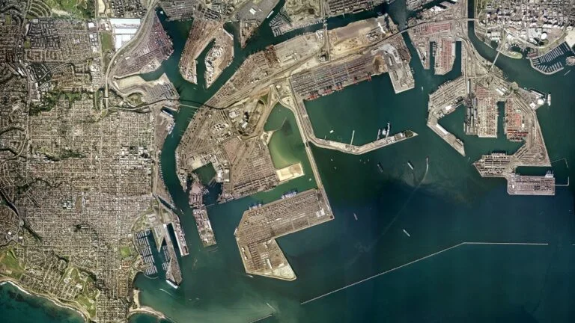
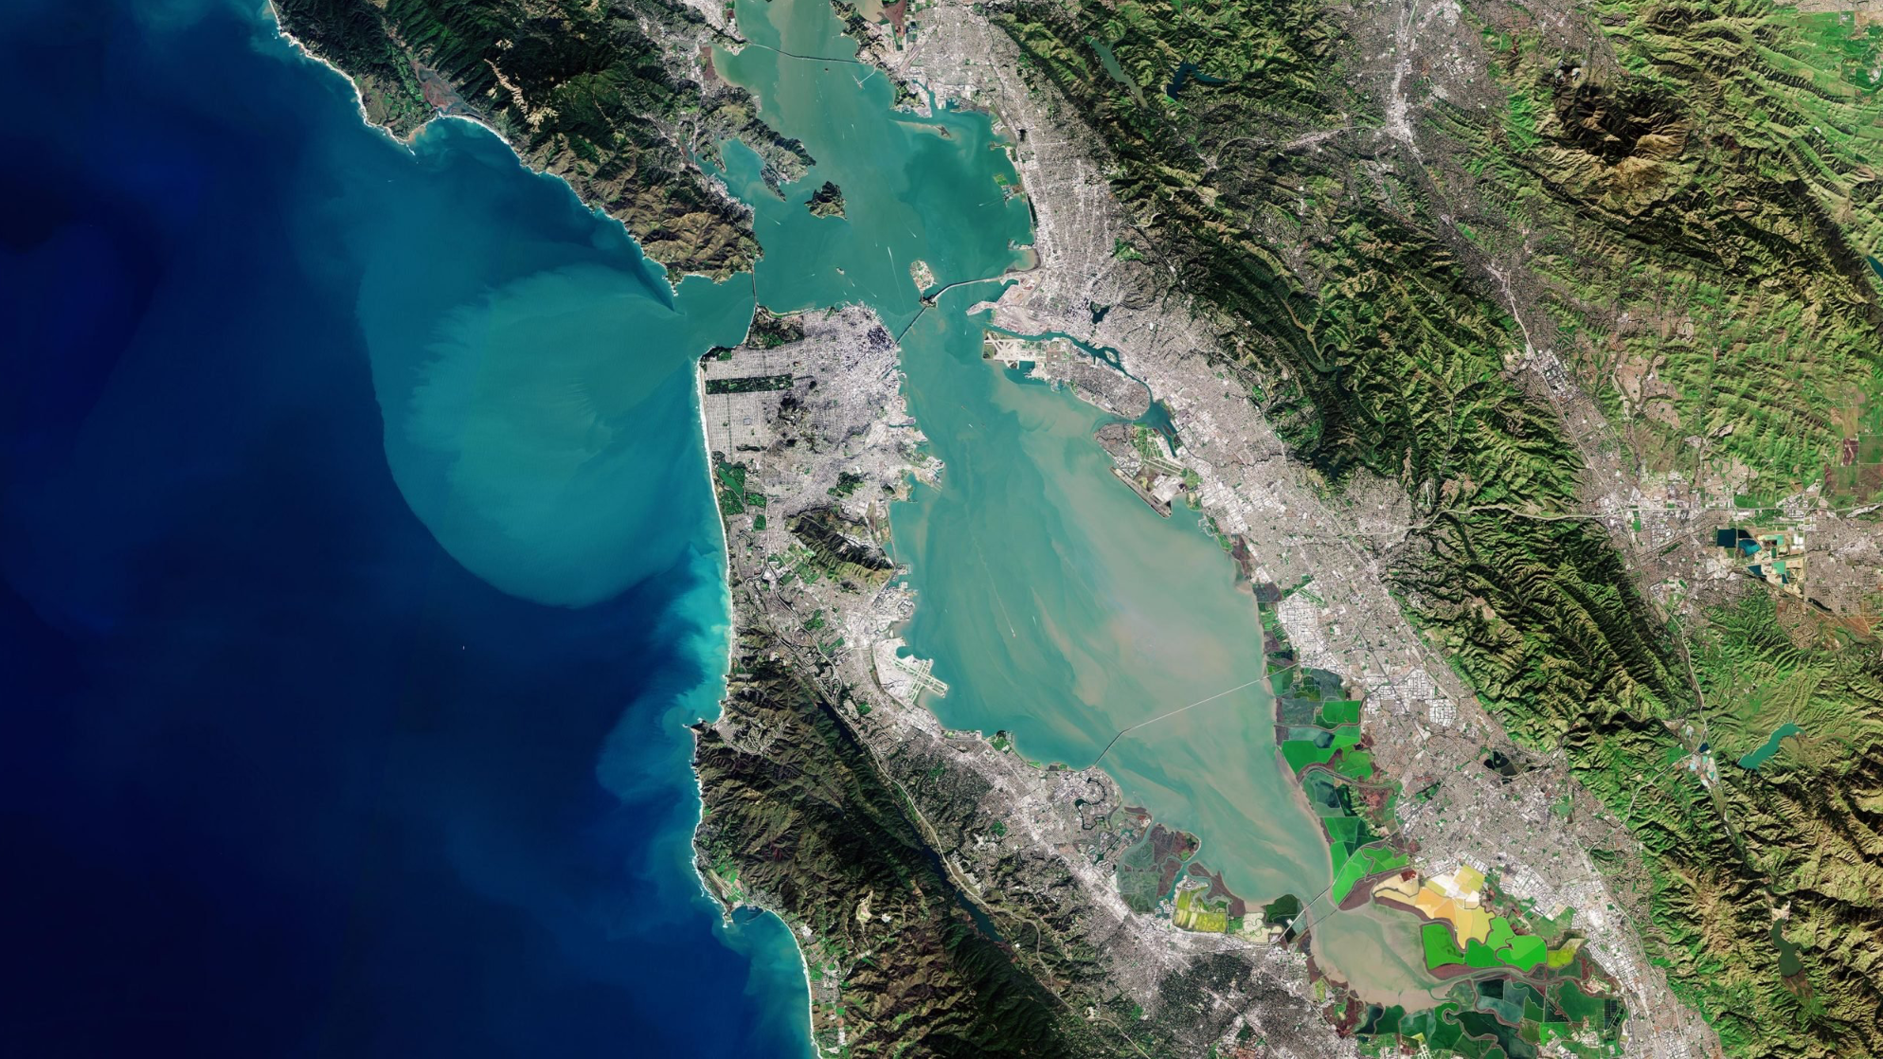
Dataset
San Pedro Bay
San Francisco Bay or San Pedro Bay
4000 80x80 RGB images
Labels
1: Ship
2: No-Ship
San Francisco Bay
Notes:
ERIC -
Thanks Alice.
There is a satellite imagery company called Planet, and their mission is to take daily pictures of the surface of the earth for various business use cases. And, this is where our dataset originates from.
Our dataset consists of satellite images over the San Francisco and San Pedro Bays in California, which you can see on this slide. The top is San Pedro Bay, and the bottom is San Francisco Bay. There actual dataset itself is 4000 color images that are 80 pixels x 80 pixels big. And all of the images have only 1 of 2 labels: SHIP or NO-SHIP. Pretty straightforward.
So with that, let’s take a deeper look at the actual dataset.

Slide 4
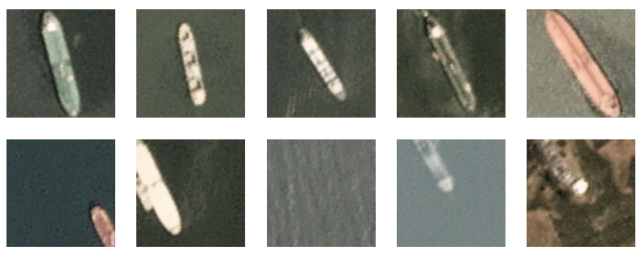
Dataset
1: Ship
0: No Ship
Notes:
Eric
So this is it, we have those 80 x 80 pixel images, and they’re either labeled SHIP, or NO-SHIP.
To be labeled as a ship, there must be a ship centered on the frame, irrespective of its orientation. It can be facing up/down, left/right, or anything else in between.
Anything else is labeled NO-SHIP, such as when a ship isn’t completely centered in the frame, or truncated in the photo, or not a ship, then you get the label NO-SHIP.
So this was our dataset, and to train our model, we used a typical 60/20/20 split.
So that’s our data; next slide

Slide 5
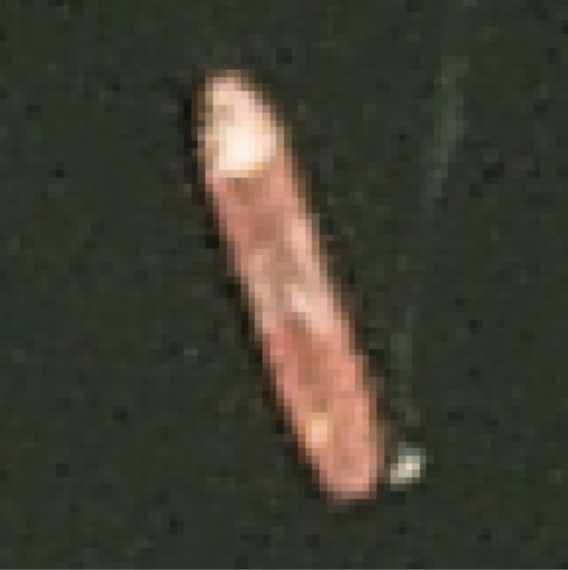
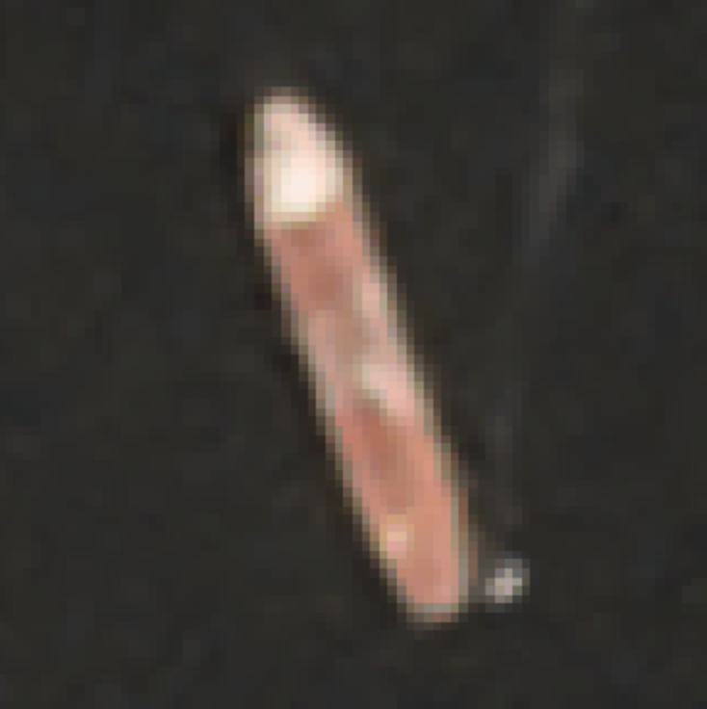
Solution and Approach
Original
Noise
Median Blur
Cloud Cover, Time of Day, Rotation
Image Augmentation
Median Blur (Window Size = 3)
Edge Detection, Scale Invariance
CNN instead of Random Forest
Notes:
We first conducted an exploratory data analysis, which informed our approach to model architecture, data preprocessing, and data augmentation.
Noise is an issue in our image data because our model may learn meaningless relationships in the noise or noisiness may make learning true relationships more difficult. To address this concern, we decided to apply a median blur to our image, which simply adjusts each pixel value to the median value of surrounding pixels in order to remove outliers and noise in the image. After visual inspection of results with different window sizes, we selected a window size of 3 as it appears to eliminate noise without significantly smoothing out salient features in each image.

Slide 6
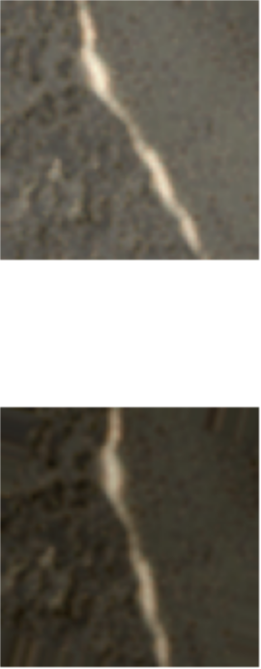
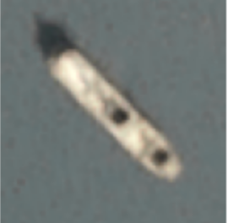
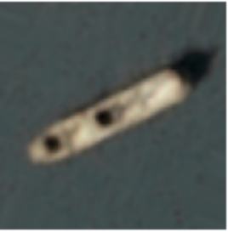
Solution and Approach
Original
Noise
Median Blur
Cloud Cover, Time of Day, Rotation
Image Augmentation
Augmented
Edge Detection, Scale Invariance
CNN instead of Random Forest
Notes:
Time of day and cloud coverage differences resulted in images that often had differences in contrast, saturation, and brightness. To address this issue, we decided to augment our training dataset by randomly adjusting each of these image qualities. We also added random rotation and reflected augmented images about the y-axis to address the differences in orientation of objects in the images. With these adjustments, we expected that our model would be able to make better classifications under a broader set of image conditions and orientations.

Slide 7
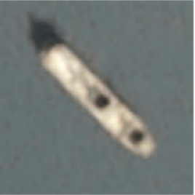
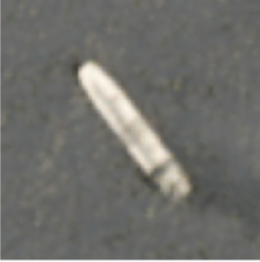
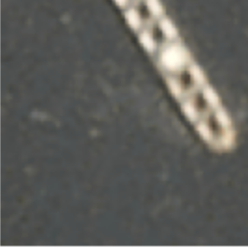
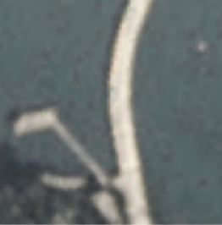
Solution and Approach
Class 1
Noise
Median Blur
Cloud Cover, Time of Day, Rotation
Image Augmentation
Class 0
Scale invariance and edge detection
CNN instead of Random Forest
Notes:
The last topic is just two interesting things we noticed about our positive and negative classes. The first is that, as you can see in the class 1 images, ships vary in size which meant that we wanted at least some degree of scale invariance. The second was that our dataset contained some particularly tricky negative class images. In the left class 0 image, you can see that although the image is of a ship, it is still in the negative class because it’s not centered. This actually kind of disincentivizes translation invariance, because we wouldn’t want a model to identify that as the positive class. And, on the right, you can see the shape of like a bridge over water that might trip up models that aren’t able to learn edges and then compose them into the shape of a ship.
With all this in mind, we ended up selecting a convolutional neural network for our main model, as we believed that the ability to learn edges and complex patterns in our images was too important for classifying our images. We also read some research that indicated that, although not perfect, they also offer some degree of scale invariance due to that same edge detection ability. However, we were initially a little bit worried that the translation invariance inherent in CNNs might lead to our model overfitting our data and being tripped up by ships that weren’t centered, so we made sure to monitor misclassifications and made sure not to use any kind of translation or cropping in our image augmentation pipeline.
Last but not least, we expected that many other model types would perform reasonably well on this task specifically because our positive class is centered. We ended up selecting a random forest because of their ability to learn nonlinearities in our data without manual intervention and used that to compare against the CNNs that we trained.

Slide 8
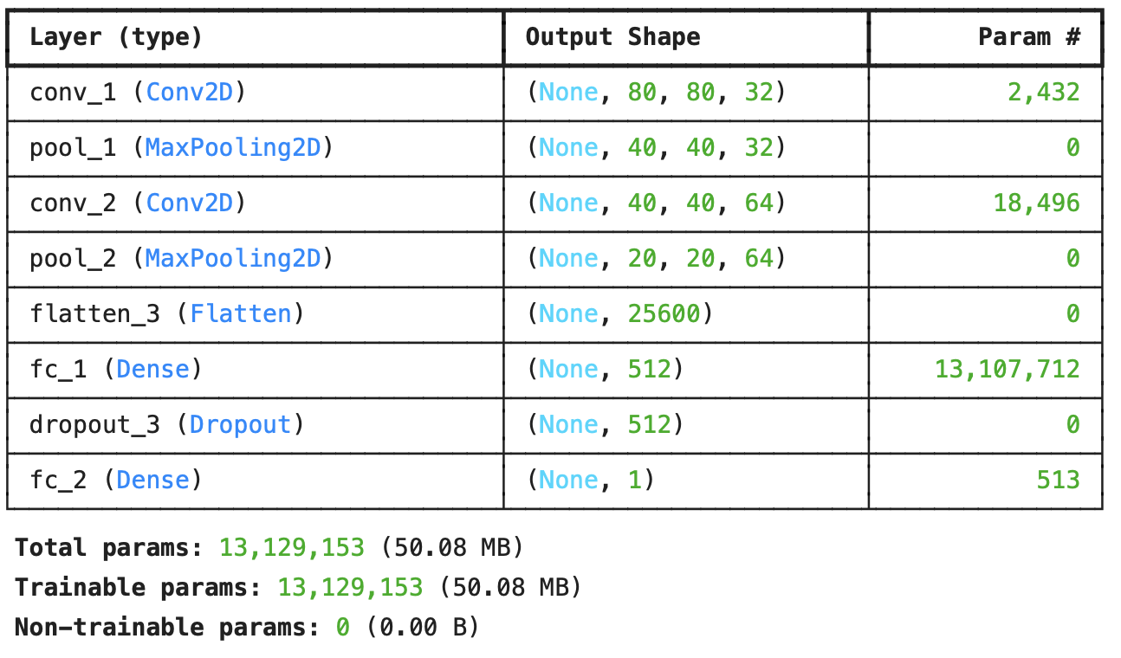
Experiments
Baseline: Random Forest
CNN Architecture V1
CNN Architecture V2
Final CNN
CNN for Edge Detection
Major Shift in Architecture
Hyperparameter Tuning
Notes:
Eliot:
Initially, we established a Random Forest classifier as our baseline model, setting the parameter “n_estimators” to 100. Subsequently, we transitioned to a CNN model architecture (Convolutional Neural Network model) which is tailored for image classification tasks, particularly binary classification. This architecture features an input layer designed for RGB images, followed by con-vo-lutional layers with 32, 64, and 128 filters, accompanied by max-pooling layers, a flatten layer, and fully connected dense layers. Comprising 128 neurons and a single neuron with sigmoid activation. The architecture adheres to a standard configuration of alternating convolutional and max-pooling layers followed by fully connected layers for classification purposes. Despite experimenting with various learning rates and conducting training for 5 epochs, all models failed to surpass our baseline model in terms of accuracy.
Finally, we employed the CNN model architecture from assignment 10, albeit with modifications to accommodate the characteristics of our data and the data augmentation process. This revised model emerged as our final model, exhibiting superior accuracy compared to our baseline model. The final model comprises multiple layers, each serving a distinct role in enhancing model performance. The initial layer, ”Conv_1, focuses on detecting edges, textures, and fundamental features within the input data. Subsequently, Conv_2 learns more complex features, contributing to the model's robustness. The "zoom lens" effect reduces dimensionality by half while preserving essential information. The output from preceding layers is flattened into 1D vectors to facilitate efficient matrix operations. Following this, the fully connected layer, “Fc_1”, builds upon features extracted by Conv_1 and Conv_2, creating a more comprehensive representation of the data. Dropout_3 is introduced to inject randomness and mitigate co-dependencies, thereby enhancing the network's robustness and ability to generalize. Finally, the last layer, Fc_2, directly maps the extracted features to the corresponding classification label,

Slide 9
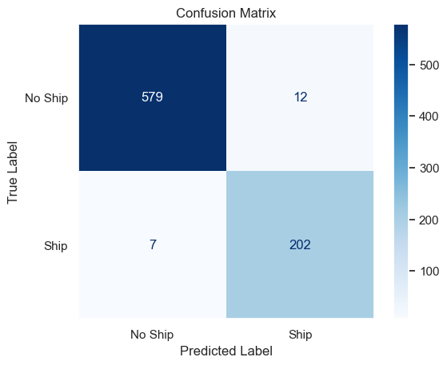
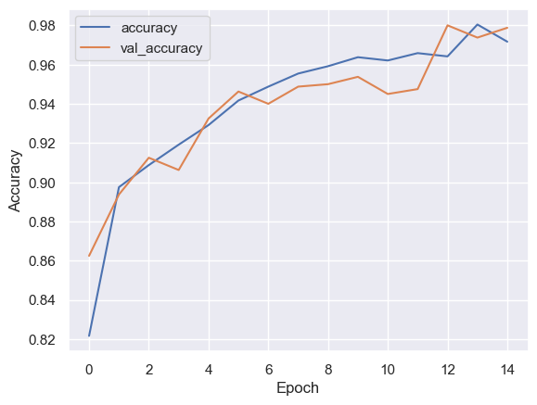
Results and Conclusion
Notes:
ERIC -
Thank you Eliot; let’s take a look at the left graph, which is our model accuracy across epochs. After all of our augmentation, experimentation, model tweaking, and most importantly - a ton of trial and error, we were able to bring our test accuracy from a baseline of 95.5% to 97%. Not too shabby. We probably could’ve probably kept going to squeeze out a tiny bit more accuracy, but we were reaching diminishing returns and figured we learned quite a bit already, so we called it.
Now, let’s take a look at the image on the right side, where you can see a confusion matrix of our correct vs incorrect predictions. We had 12 false positives (12 / (12+202) == 5.6%), and 7 false negatives (7 / (7+579) == 1.2%). The false positive rate is much higher than the false negative rate (5.6% vs 1.2%), which we attributed to our training dataset having much more negatives labels than positive labels. So to address this, one approach would’ve been to augment more data to balance the training labels.
So those are our results from our model building exercise; thank you; next slide please

Slide 10



Ethical, Legal, and Personal Concerns
Privacy: Surveillance, Data Security
Algorithmic Bias: Biased Data Leads to Biased Results
Limitations: Geospatial Generalizability
Notes:
ALICE

Slide 11
NeurIPS Checklist
For all authors...
Do the main claims made in the abstract and introduction accurately reflect the paper's contributions and scope? yes
Have you read the ethics review guidelines and ensured that your paper conforms to them? yes
Did you discuss any potential negative societal impacts of your work? yes
Did you describe the limitations of your work? yes
If you are including theoretical results...
Did you state the full set of assumptions of all theoretical results? n/a
Did you include complete proofs of all theoretical results? n/a
If you ran experiments...
Did you include the code, data, and instructions needed to reproduce the main experimental results (either in the supplemental material or as a URL)? yes
Did you specify all the training details (e.g., data splits, hyperparameters, how they were chosen)? yes
Did you report error bars (e.g., with respect to the random seed after running experiments multiple times)? yes
Did you include the amount of compute and the type of resources used (e.g., type of GPUs, internal cluster, or cloud provider)? yes
If you are using existing assets (e.g., code, data, models) or curating/releasing new assets...
If your work uses existing assets, did you cite the creators? yes
Did you mention the license of the assets? yes
Did you include any new assets either in the supplemental material or as a URL? yes
Did you discuss whether and how consent was obtained from people whose data you're using/curating? yes
Did you discuss whether the data you are using/curating contains personally identifiable information or offensive content? yes
If you used crowdsourcing or conducted research with human subjects...
Did you include the full text of instructions given to participants and screenshots, if applicable? n/a
Did you describe any potential participant risks, with links to Institutional Review Board (IRB) approvals, if applicable? n/a
Did you include the estimated hourly wage paid to participants and the total amount spent on participant compensation? n/a
Notes:
ALICE

Slide 12
Works Cited
D. Scherer, A. Muller, and S. Behnke. Evaluation of pooling ¨ operations in convolutional architectures for object recognition. In Artificial Neural Networks–ICANN 2010, pages 92– 101. Springer, 2010.
(ESA), European Space Agency. “Satellite Captures Incredible Detailed View of San Francisco Bay from Space.” SciTechDaily, 19 Apr. 2023, scitechdaily.com/satellite-captures-incredible-detailed-view-of-san-francisco-bay-from-space/.
Nedelina Teneva, UC Berkeley School of Information. DATASCI W207: Applied Machine Learning Assignment 10. Spring 2024.
Shore, Leah. “5. Why We Have Two Major Seaports in San Pedro Bay.” USC Sea Grant, 19 Dec. 2023, dornsife.usc.edu/uscseagrant/2020/08/31/5-why-we-have-two-major-seaports-in-san-pedro-bay/.

Slide 13
Privacy: Surveillance, Data Security
Algorithmic Bias: Biased Data Leads to Biased Results
Limitations: Geospatial Generalizability

Slide 14
Contributions
Alice: Problem Motivation, Ethical/Legal/Personal Concerns, NeurIPS Checklist, Reviewing Code, Initial Powerpoint Draft, Initial Report Draft of All Sections
Eliot: Trained a random forest baseline model and CNN. Experimented with three different learning rates (0.001, 0.0001, 0.00001) and the Adam optimization function. Trained the final model using 10 epochs
Eric: Dataset, Results & Conclusion, Model Architecture, Model Evaluation
Kenneth: EDA, Identified Experiments to Test, Implemented Experiments Image Preprocessing & Augmentation Experiments, Evaluated Model Performance

Slide 15
Thank You

